Slide 1




February 25th 2025
CAPSTONE
PROJECT
Safe Alert:
The Recall Tracking System
Team Members:
Nisrine Hafid
Thuong Pham
Soliyana Tenagne
Trent Korycinska
Will Peng

Slide 2



Mission Statement
The mission of our company, Safe Alert, is to provide a completely FREE service through our website to quickly notify users about recalled items, helping them make safe choices before purchasing or using them. Our service ensures users receive fast, accurate, and accessible information, because in food safety, time is of the essence.

Slide 3
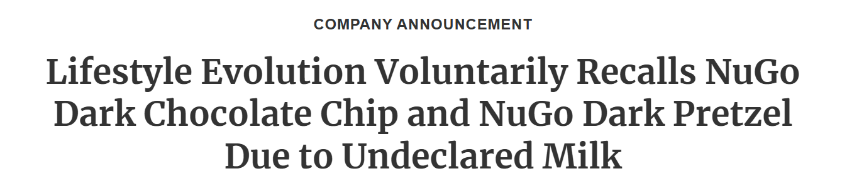
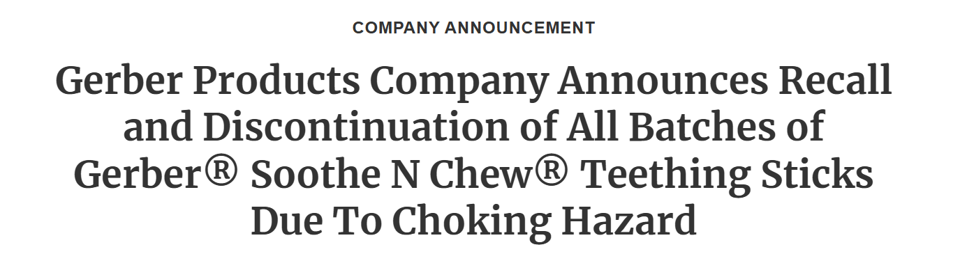
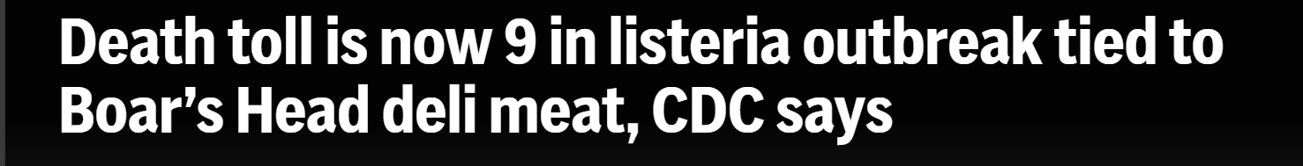
EXAMPLES OF RECALLS
January 10, 2025 – 11 Reports of Allergic Reactions
Lifestyle Evolution Voluntarily Recalls NuGo Dark Chocolate Chip and NuGo Dark Pretzel Due to Undeclared Milk | FDA
January 31, 2025 – Multiple Choking Incidents (Including 1 Emergency Room Visit)
Gerber Products Company Announces Recall and Discontinuation of All Batches of Gerber® Soothe N Chew® Teething Sticks Due To Choking Hazard | FDA
July 30, 2024 – 9 Deaths
8 deaths linked to listeria outbreak tied to Boar's Head deli meat, CDC says | AP News

Slide 4




WHAT IS THE PURPOSE OF THIS SITE?
The Recall Tracking System website will:
Track and notify users of recalled items
Provide accurate information on food products
Time-efficient
Organized
User friendly
Free!!!

Slide 5




HOW MUCH ARE YOU WILLING TO PAY?
Tools:
Google Site (domain): free
Tableau Public: free
Marketing: free
Tik Tok
Instagram
Twitter
Facebook
API’s: free
FDA’s data
CDC’s data
Visual Studio: free
Python: free
HTML: free
CSS: free
Human Resources:
Nisrine Hafid: volunteer
Thuong Pham: volunteer
Soliyana Tenagne: volunteer
Trent Korycinska: volunteer
Will Peng: volunteer
Our entire team is made up of volunteers, we worked together to come up with this idea and really believe in it. We are all dedicated to putting in the time and work to make it come to life without any sort of pay or compensation.
Our company wants to start off as a non-profit, but we’re accepting donations from users that like our service.

Slide 6
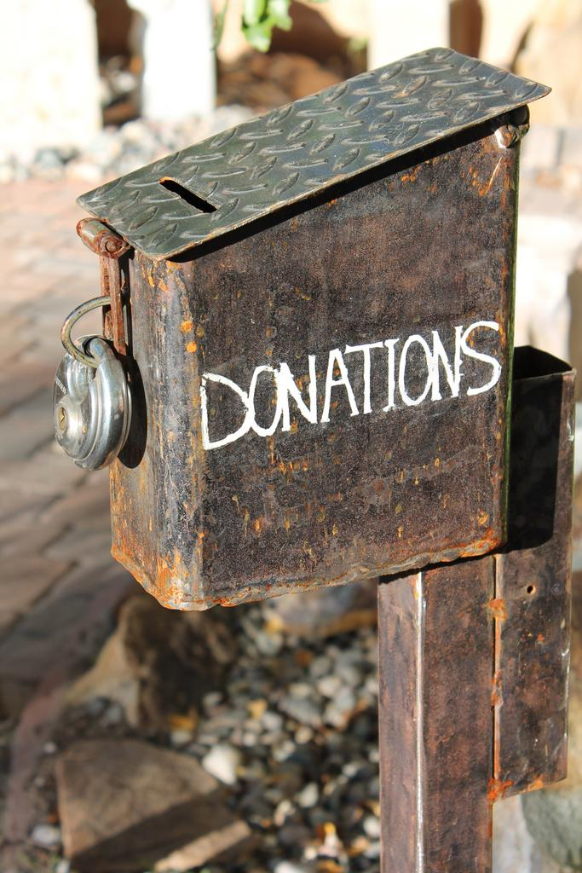
How will
donations work?
The service will be free to use, but donations will be accepted.
A "Donate" button will be available on the main navigation bar, allowing users to visit the donations page at any time.
Donation money will be sent to our organization's GoFundMe account and will mostly be used to maintain and improve the service.

Slide 7
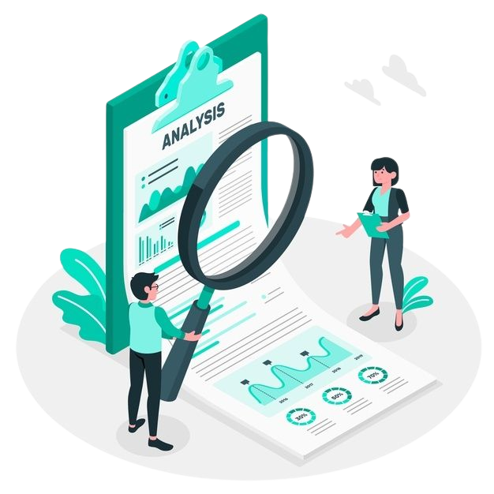


Families:
Moms
Dads
Grocery shopper for household
Restaurant owners
Cooks/chefs
Grocery chains
Schools
Hospitals
TARGET MARKET

Slide 8
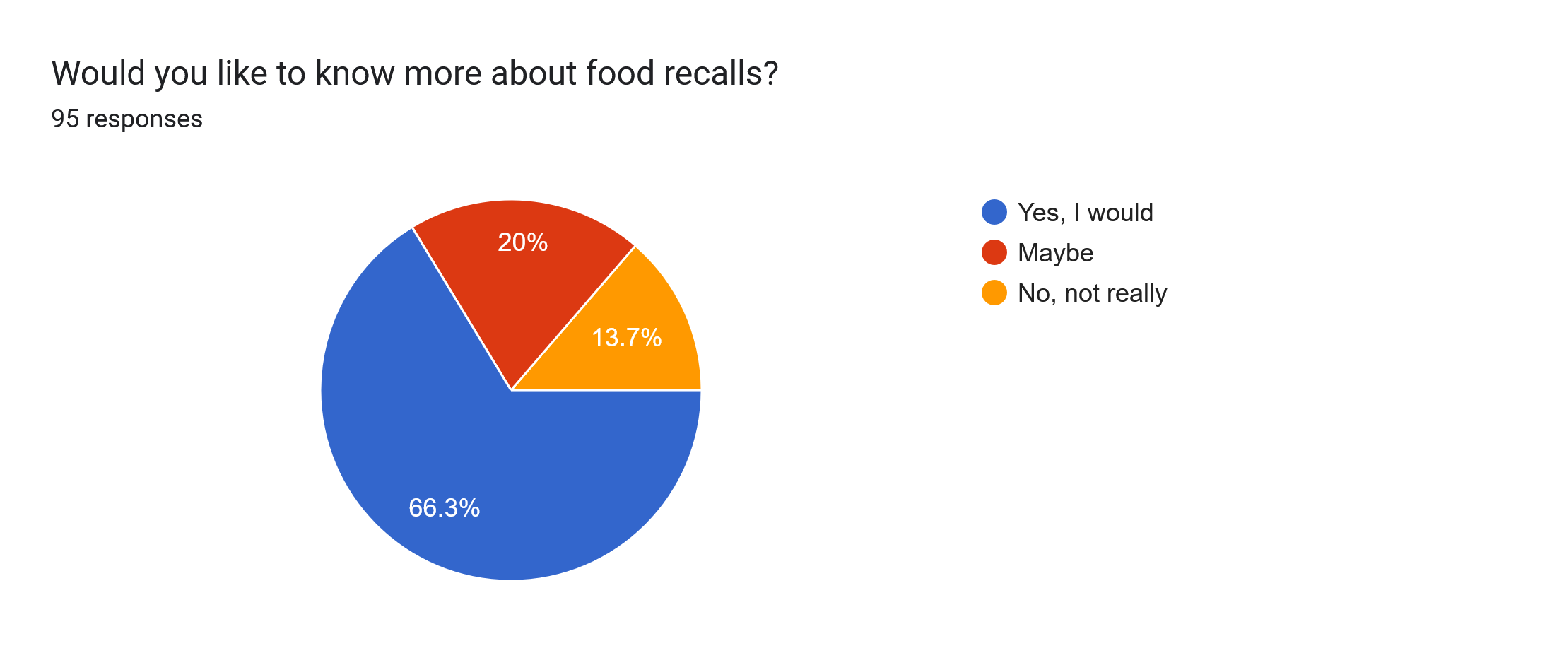

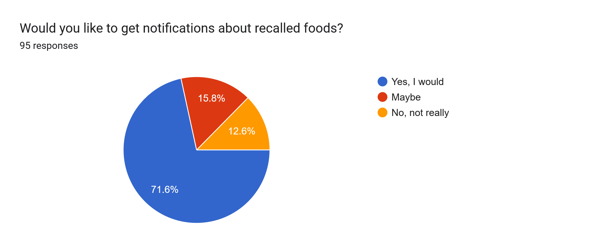
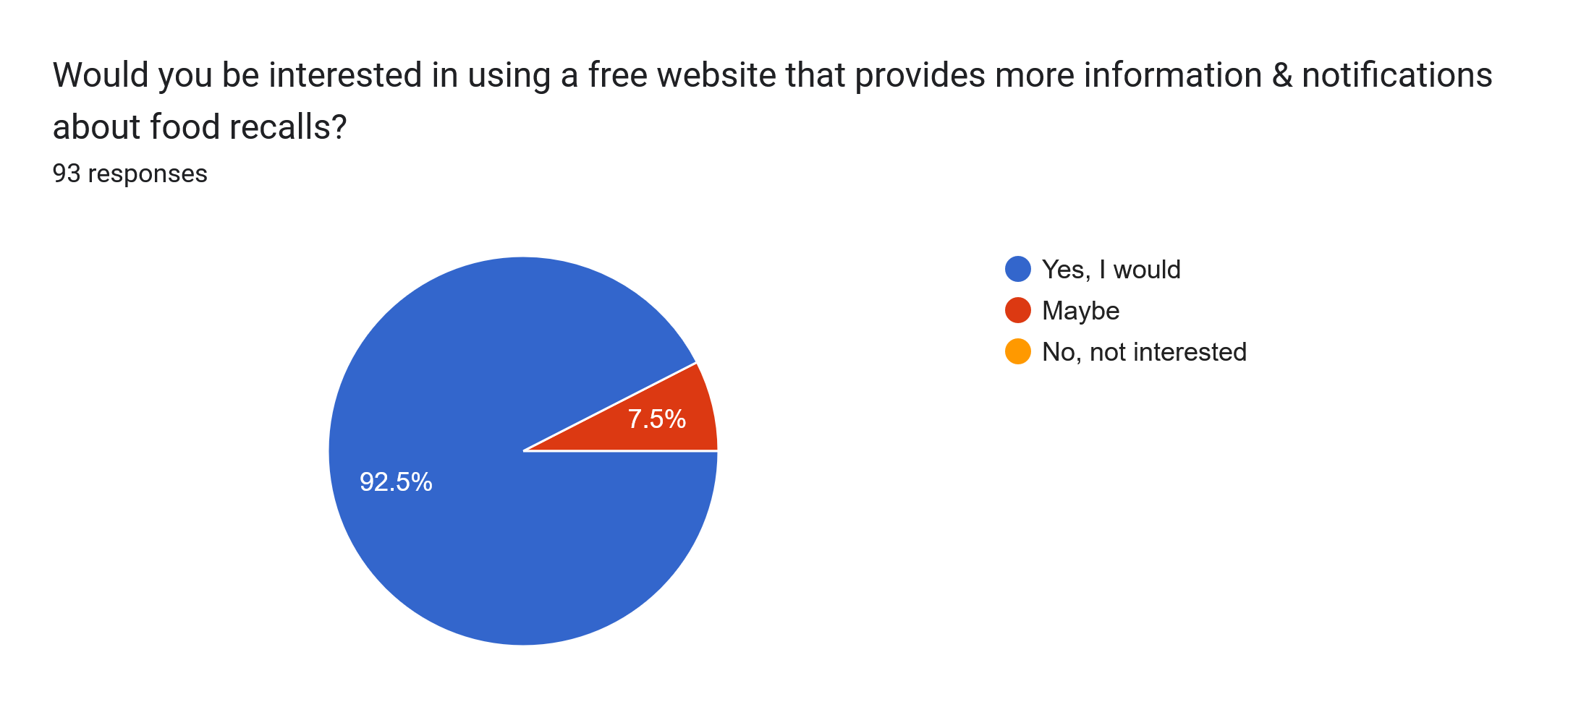
Survey Responses:

Slide 9
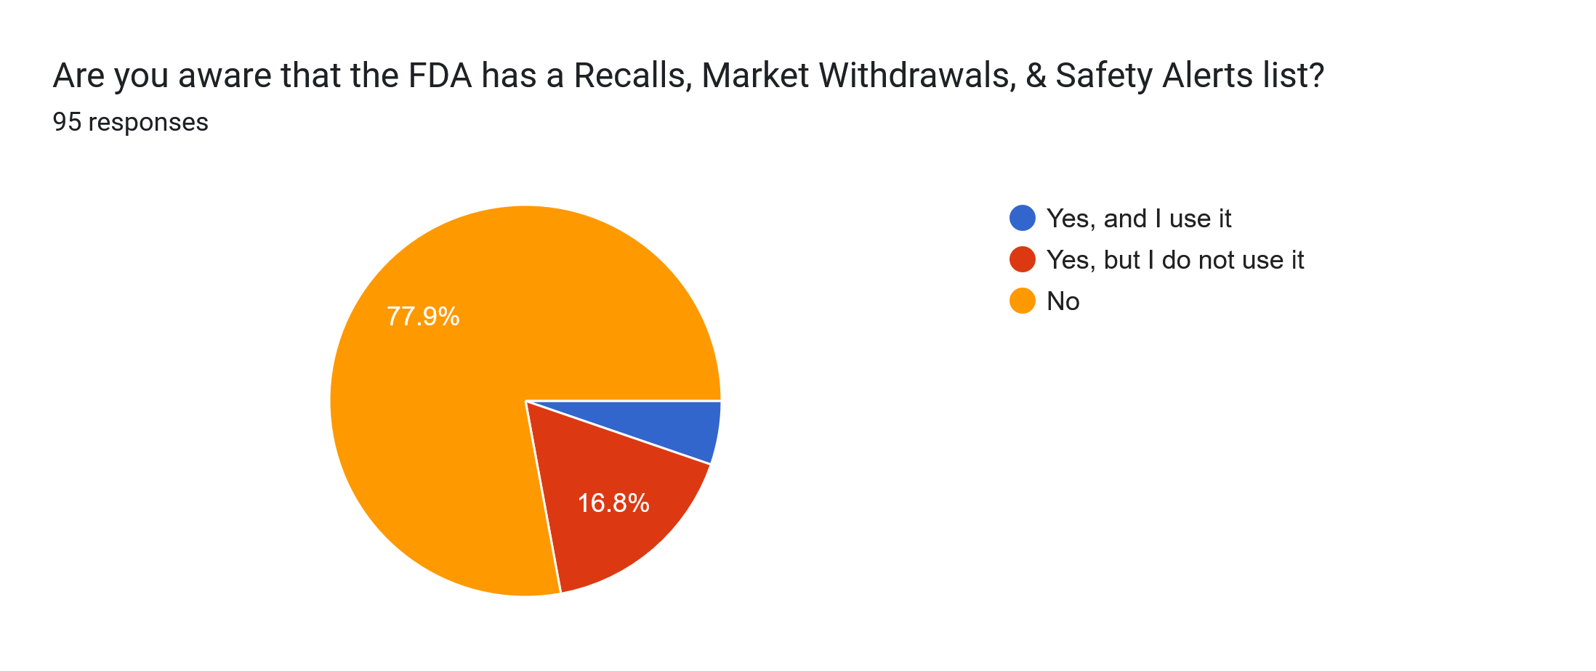
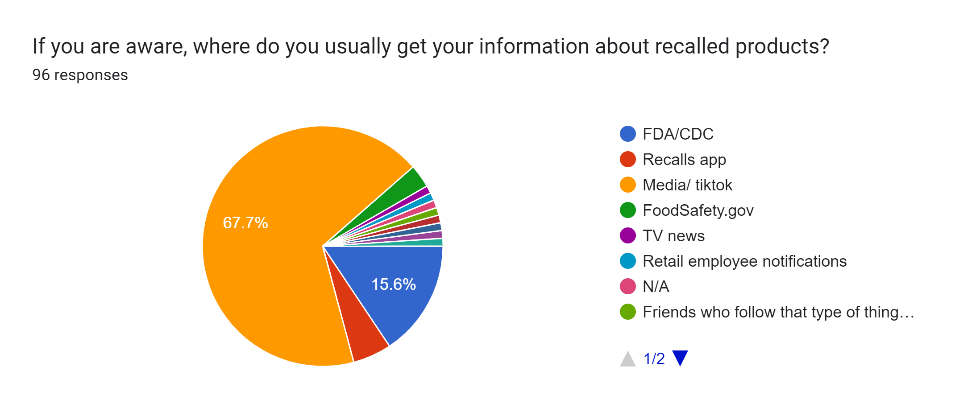
Survey Responses(cont'd):
Responses as of Feburary 17, 2025. Runtime of about 6 days.
Vast majority does not know the FDA list exists.
Similar number would like a free website that provides more information and notifications on food recalls.
Complete Survey Results

Slide 10



WHY WE ARE BETTER THAN OTHER COMPETITION
Likes:
Provides info on items outside of food
Dislikes:
Unorganized
No advertising
The Recall Tracking System Improvements:
Information and items will be categorized for quick and easy access
Website will be advertised and will draw in many demographics
Likes:
Has a very large audience
Interface can be very informative
Dislikes:
Does not focus entirely on recalls
Information user receives depends on their algorithm
The Recall Tracking System Improvements:
Website brings recall news to the forefront
Unlike Tik Tok our website will user friendly for all ages
(Tik Tok can be harder to use for someone who isn’t tech-savvy)
Likes:
Quick to collect data from various sources
Dislikes:
No notification system
The Recall Tracking System Improvements:
Website will have a fast and efficient notification system
Likes:
Provides pictures of items
Linked up with FDA announcements
Dislikes:
Not free, there are in app purchases to access features like a notification system
The app looks cluttered and unorganized, not pleasing to the eye
The Recall Tracking System Improvements:
Our website includes all these features in a more organized manner FOR FREE!!

Slide 11


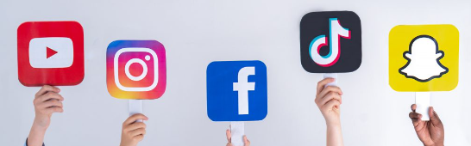


MARKETING
We’re going to utilize free social platforms such as Instagram/Facebook/Meta, TikTok, Twitter/X, etc.
To start off we will be advertising entirely online.
In the future, to gain more attraction, we will use our donations to create physical advertisements: flyers, business cards, etc.

Slide 12

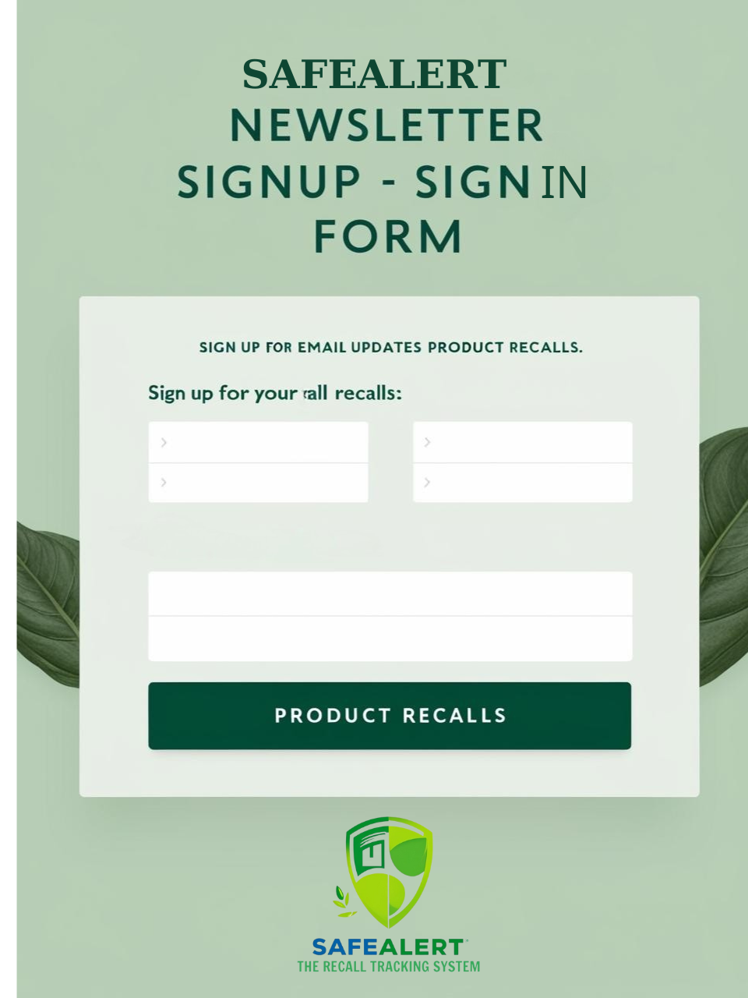
ONLINE ​
NEWSLETTER
Due to us providing a newsletter, we will be asking for anyone interested in receiving news and updates about recalls to sign up for our personal newsletter.​
​
To do this, we will be using Firebase to host and store all of those that signed up for our newsletter and use that database to automate sending out our updates. Not only can we use Firebase to store emails, but also for email authentication as well.​
​

Slide 13




The Recall Tracking System
“ Track food recalls. Stay safe”
HOME | SUPPORT | RECALL ITEMS | NOTIFICATION SIGN UP
MEAT (2017-2025) | POULTRY (2017-2025) | SEAFOOD (2017-2025) | DAIRY (2017-2025) | FRUITS & VEGETABLES (2017-2025) | FROZEN FOOD (2017-2025)
Filter
You can filter your search by date or brand name here
DATE | BRAND NAME(S): | DESCRIPTION: | PRODUCT TYPE: | REASON FOR RECALL

Slide 14

THANK YOU

